Slide 1
Machine Learning
Unit-4

Slide 2
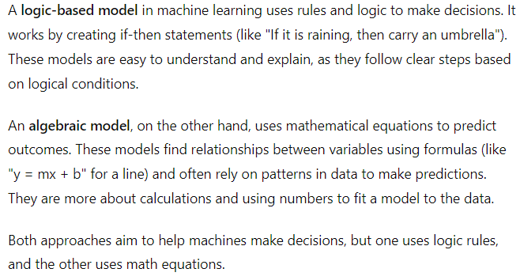
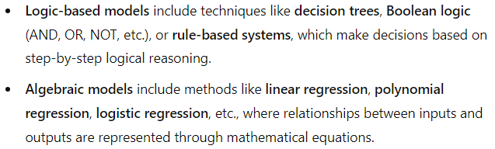
Logic-based and algebraic model

Slide 3
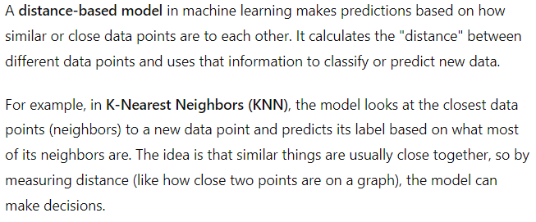
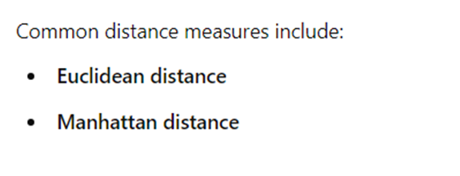
Distance-based model

Slide 4
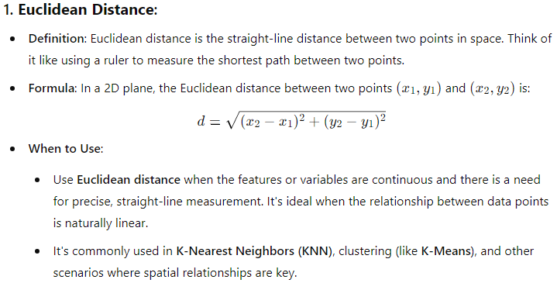

Slide 5
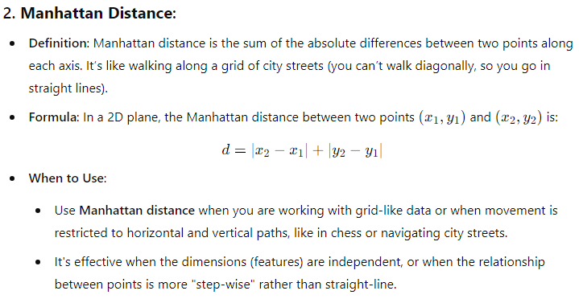

Slide 6
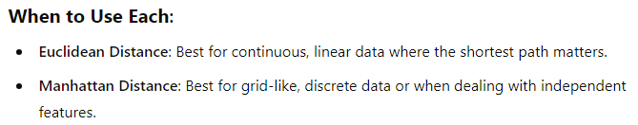
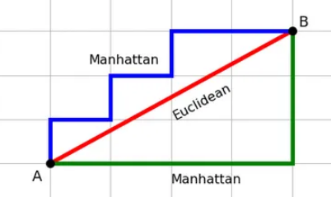

Slide 7
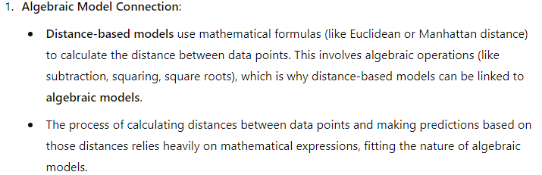
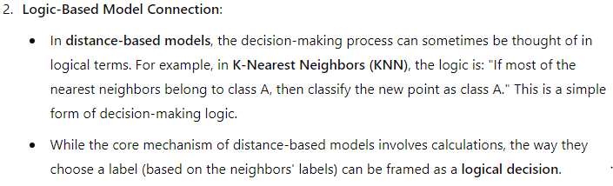
How Distance-based model is connected to Logic-based and algebraic model:

Slide 8
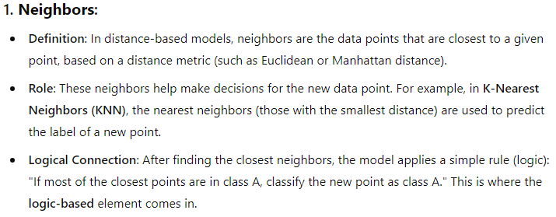
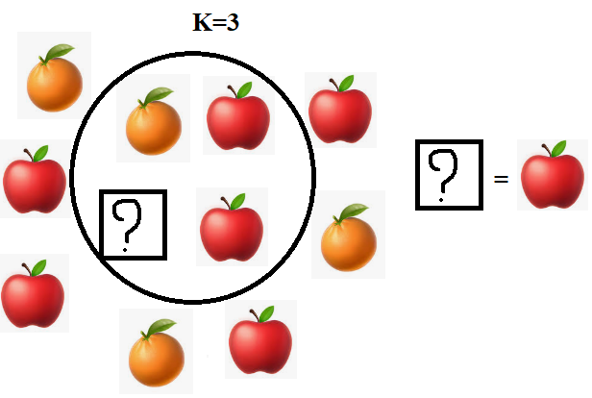
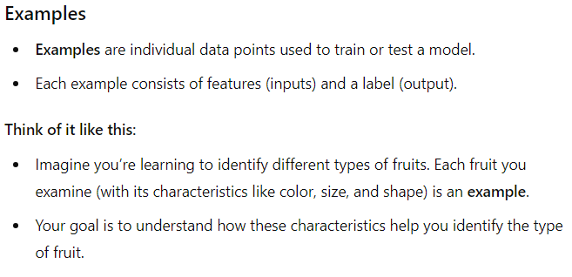
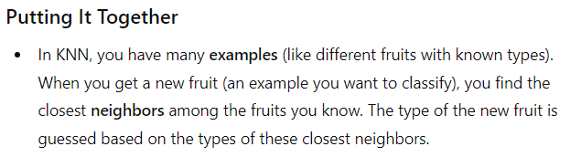
Neighbors and examples

Slide 9
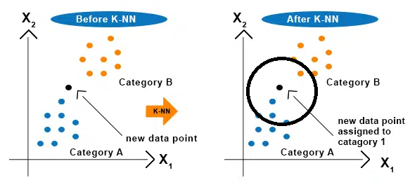
Nearest Neighbours Classification

Slide 10
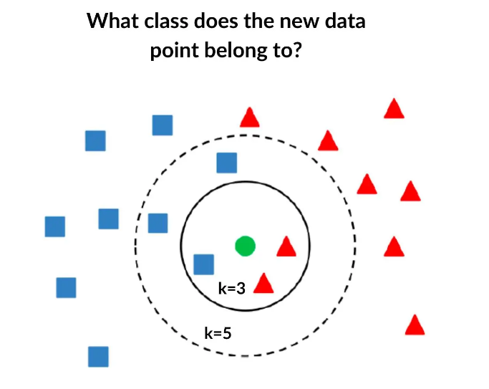

Slide 11
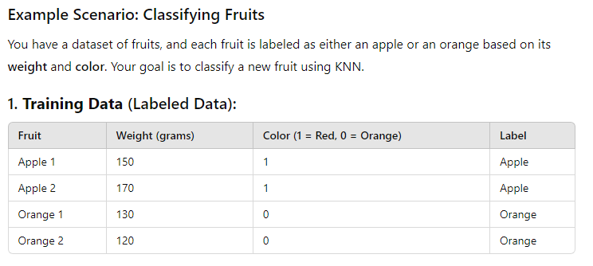
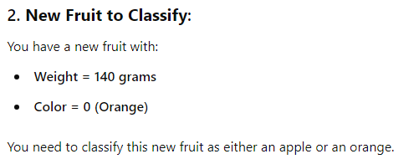

Slide 12
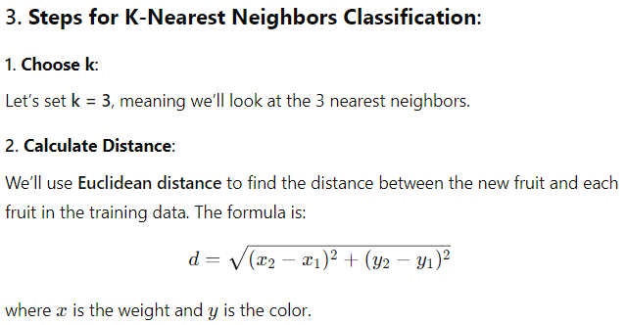
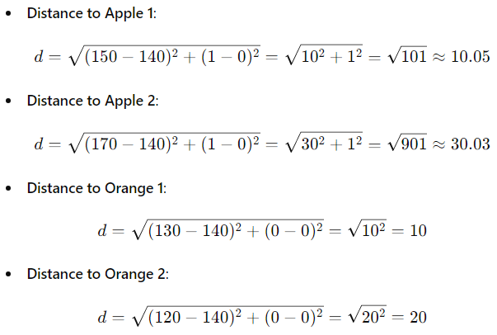

Slide 13
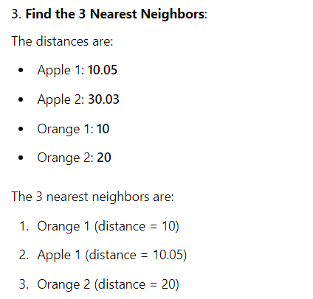
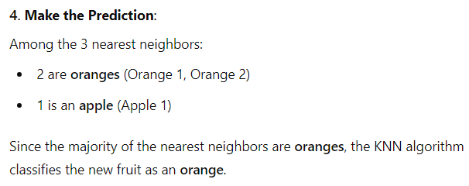
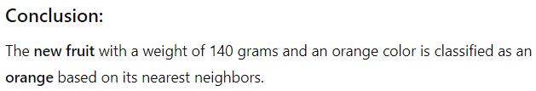

Slide 14
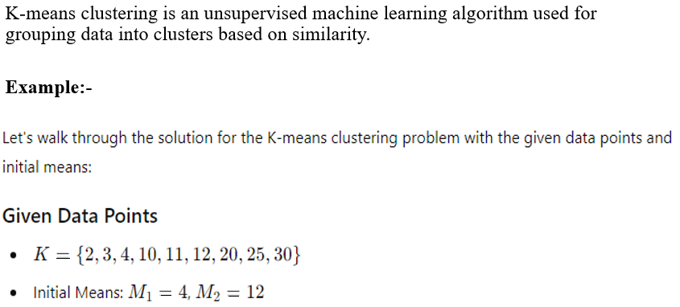
Distance based K-Means Clustering Algorithm
Since the K-Means Clustering algorithm always involves calculating distances between points and centroids, it is often described as a distance-based clustering method.

Slide 15
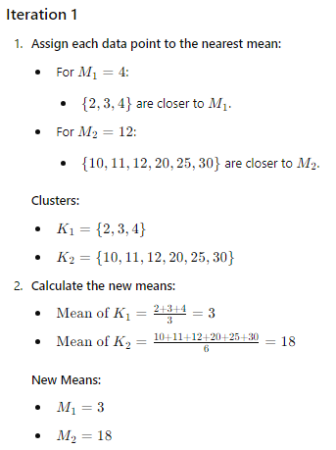
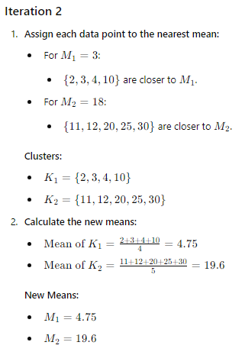

Slide 16
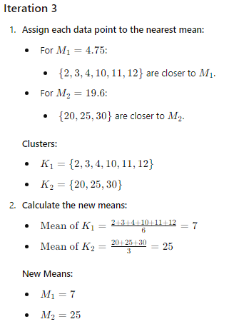
At this point, if the assignments of points to clusters do not change, the algorithm has converged, and these are the final clusters. Otherwise, you would continue iterating, recalculating means, and reassigning points until convergence.

Slide 17
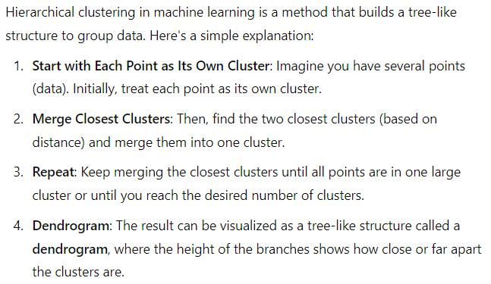
Hierarchical clustering

Slide 18
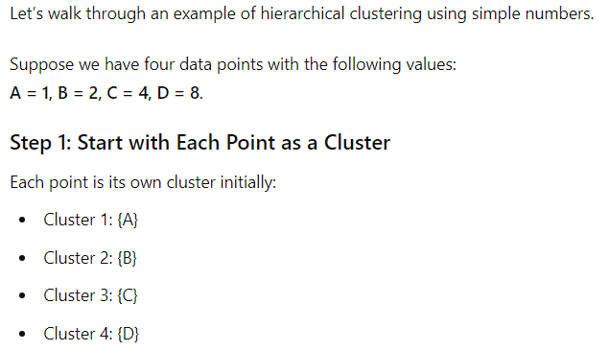

Slide 19
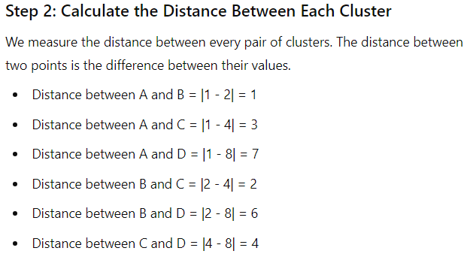

Slide 20
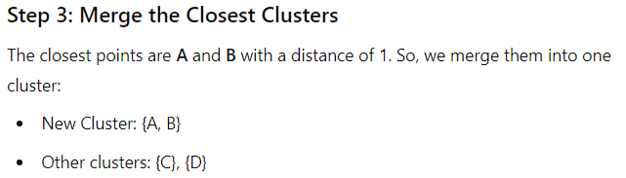
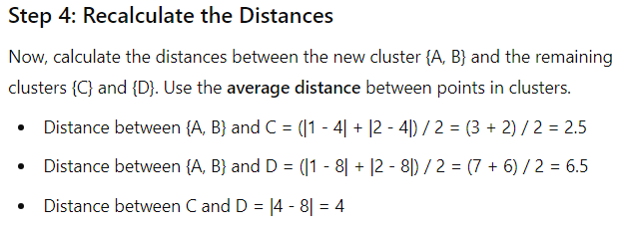

Slide 21
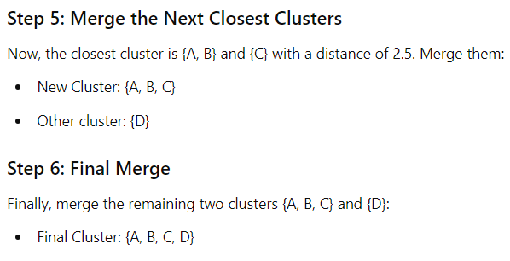
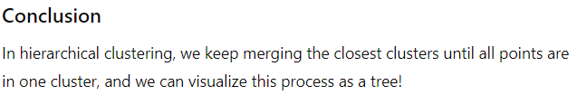

Slide 22
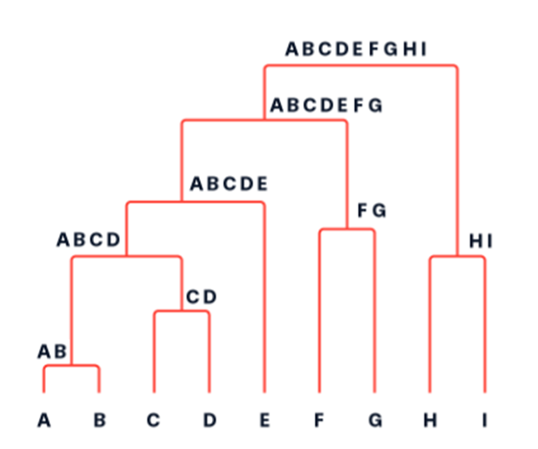
A dendrogram is a tree diagram frequently used to illustrate the arrangement of the clusters produced by hierarchical clustering.

Slide 23
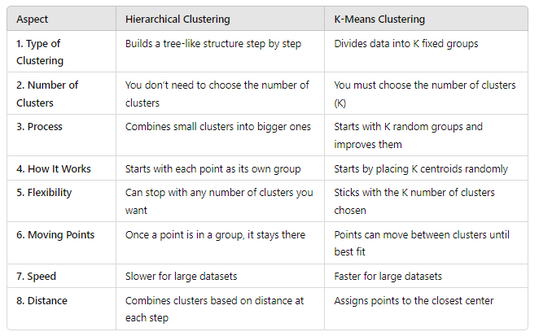
Difference between Hierarchical clustering and Distance based K-Means Clustering Algorithm.

Slide 24
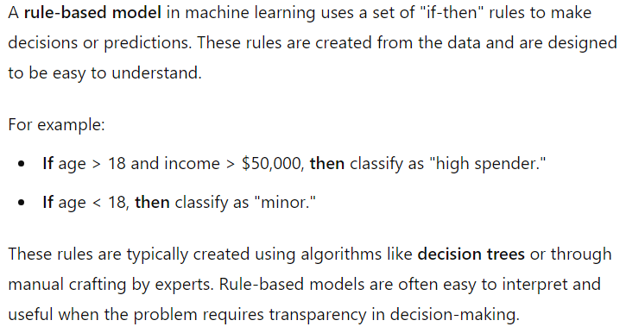
Rule Based Models

Slide 25
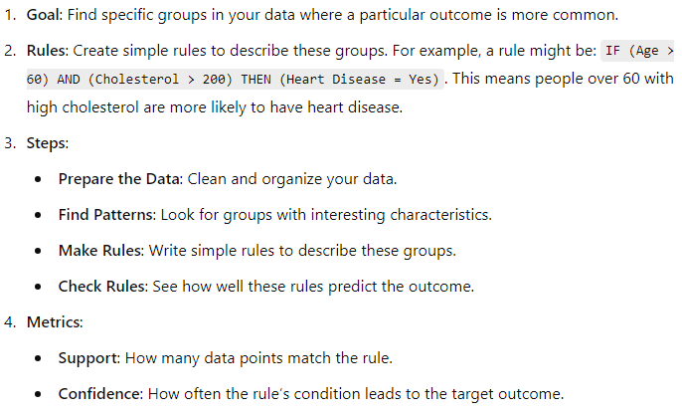
Rule learning for subgroup discovery

Slide 26
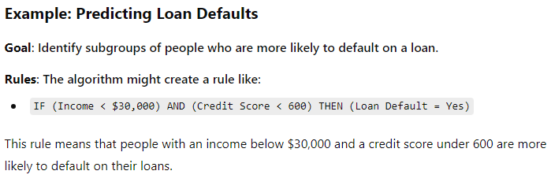
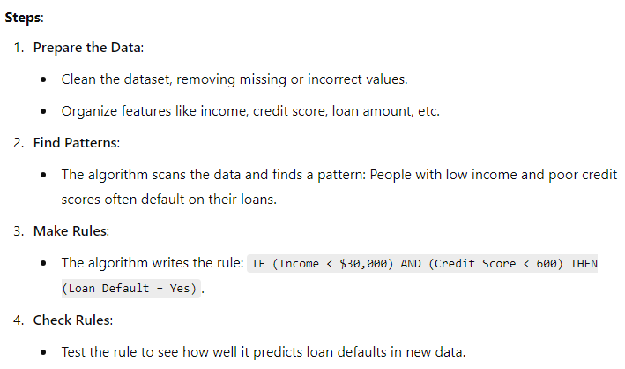
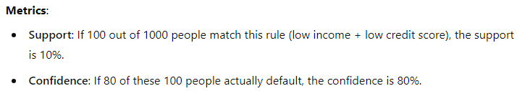

Slide 27
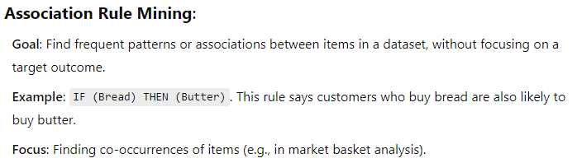
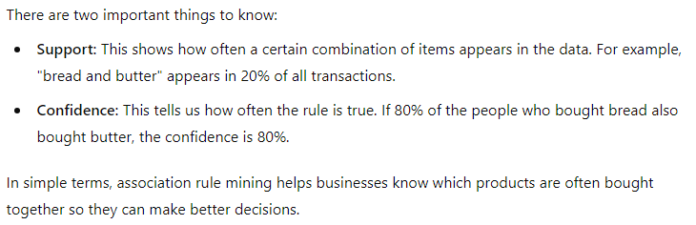
Association Rule Mining

Slide 28
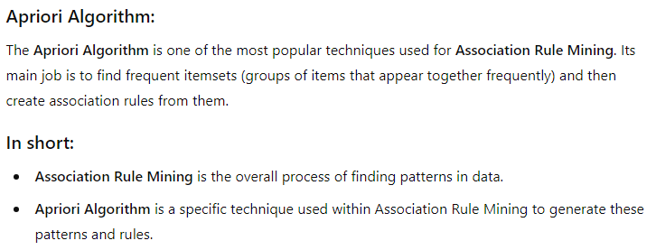
Apriori Algorithm is a method that falls under Association Rule Mining.

Slide 29
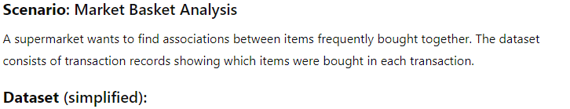
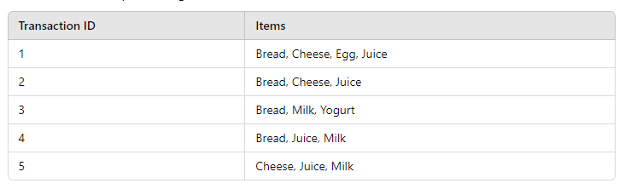
Example of Apriori Algorithm:-

Slide 30
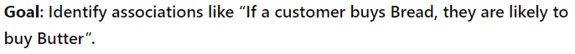

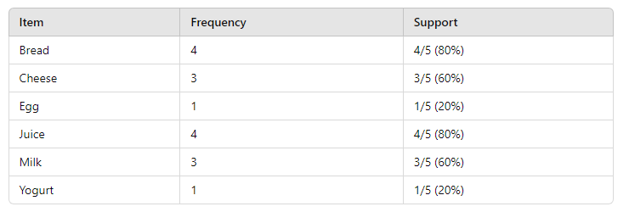
Given Minimum Support Threshold: 50%

Slide 31
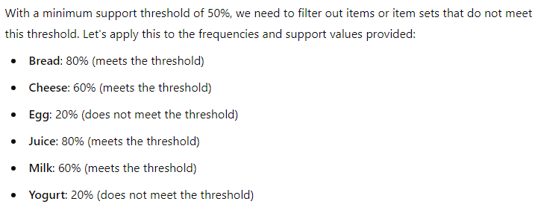
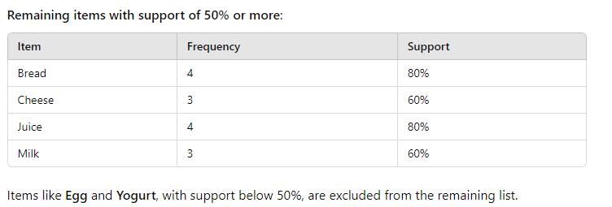

Slide 32



Slide 33



Slide 34



Slide 35


Slide 36



Slide 37



Slide 38



Slide 39

Tree-based model
Tree-based models are a type of supervised machine learning algorithm used for both classification and regression tasks.
These models work by splitting the dataset into smaller subsets based on specific criteria, typically using decision rules, to form a tree-like structure.
Some of the most popular tree-based models include Decision Trees, Random Forests, and Gradient Boosting Machines (GBM).

Slide 40



Decision Trees

Slide 41

Decision Tree example:-

Slide 42

Ranking and Probability Estimation Trees
Example of Ranking Tree:-

Slide 43



Slide 44


Example of a Ranking Tree:-

Slide 45




Slide 46


Probability Estimation Tree Example:-

Slide 47



Slide 48



Slide 49

Another example of Probability Estimation Tree:-

Slide 50



Slide 51



Slide 52

Regression Trees
A Regression Tree is a type of decision tree used when we want to predict continuous values (like predicting house prices, temperatures, etc.) rather than categorical values (like "Yes" or "No").

Slide 53


Decision Tree vs. Regression Tree

Slide 54



Slide 55


Slide 56



Clustering Trees

Slide 57


The dendrogram is often referred to as a "clustering tree." It visually represents the results of hierarchical clustering.

